Slide 1

Lecture-2
Process Management & CPU Scheduling
Core Topics:
Process Lifecycle
Context Switching, PCB, Threads (User vs Kernel)
CPU Scheduling Algorithms (FCFS, SJF, Priority, Round Robin, Multilevel)
Books
Operating System Concepts Ninth Edition
Avi Silberschatz Peter Baer Galvin Greg Gagne
Operating Systems: Internals and Design Principles
William Stallings

Slide 2

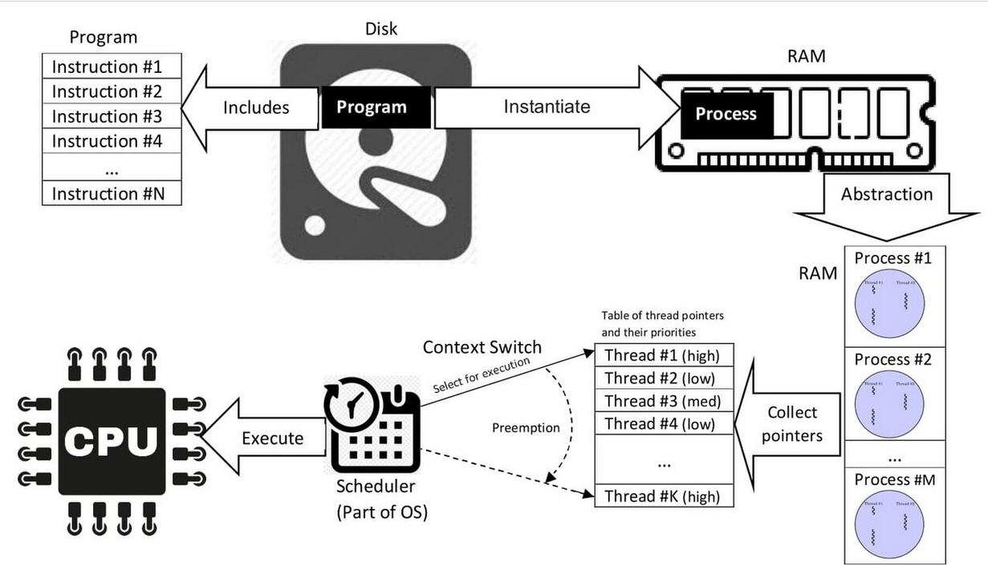
A process is a program in execution.
What is Processes?

Slide 3
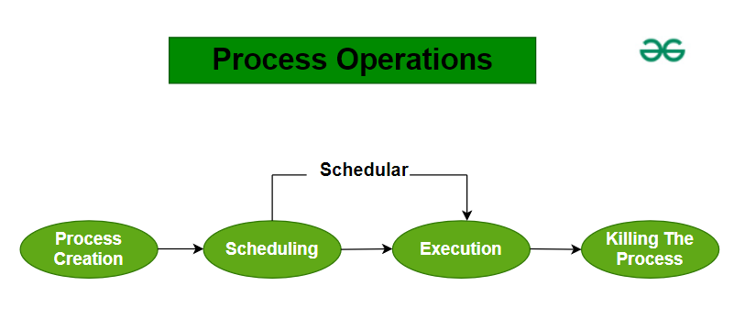
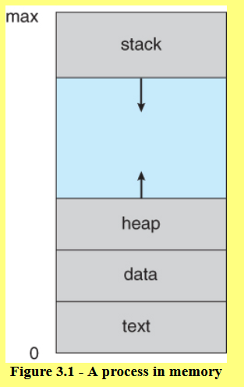
Process in Memory and Operations
Used for local variables
Used for dynamic memory allocation, and is managed via calls
Stores global and static variables, allocated and initialized prior to executing main.
comprises the compiled program code

Slide 4
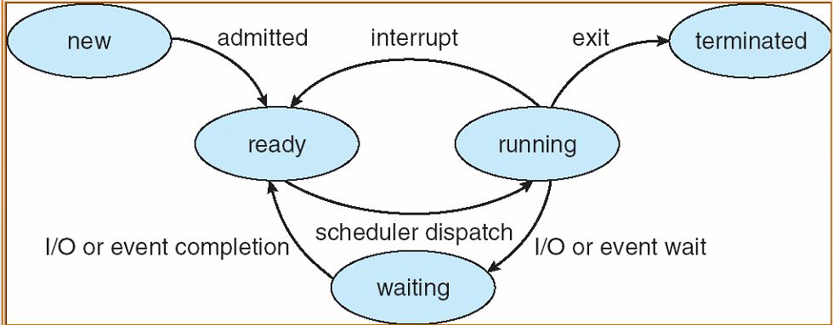
Process Life Cycle (Process States)

Slide 5
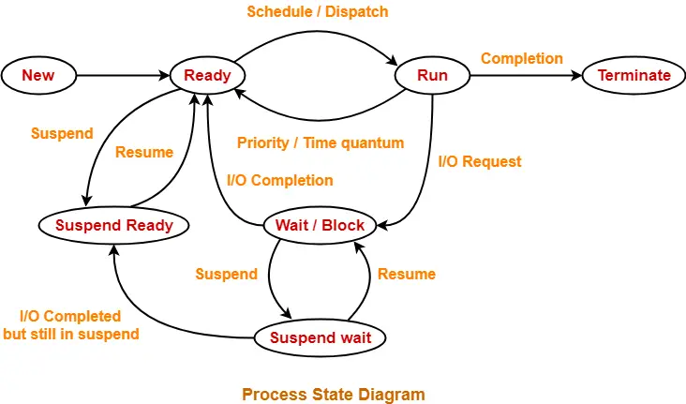
Process Life Cycle (Process States)

Slide 6
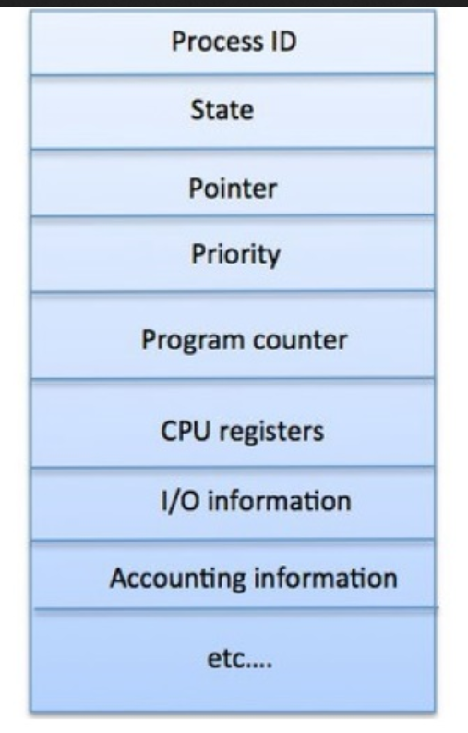
Process Control Block (PCB)
Information associated with each process
(also called task control block)
Process state – running, waiting, etc
Program counter – location of instruction to next execute
CPU registers – contents of all process-centric registers
CPU scheduling information- priorities, scheduling queue pointers
Memory-management information – memory allocated to the process
Accounting information – CPU used, clock time elapsed since start, time limits
I/O status information – I/O devices allocated to process, list of open files

Slide 7
Thread
Despite of fact that a thread must execute in processes, the processes and its associated threads are different concept.
Process are used to group resources together and threads are the entities scheduled for execution on the CPU.
A thread is a single sequence stream within in a process. Because threads have some of the properties of processes, they are sometime called light weight processes.
In a process, threads allows multiple executions of streams. In many respect, threads are popular way to improve application through parallelism.
The CPU switches rapidly back and forth among the threads giving illusion that the threads are running in parallel.

Slide 8
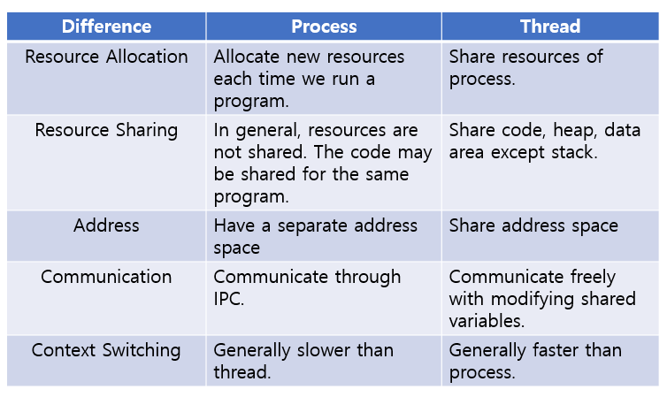
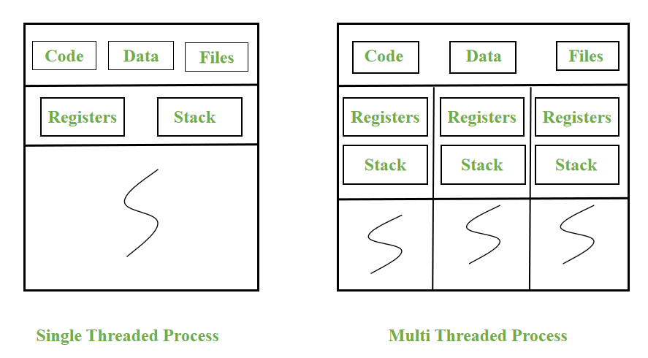
Processes Vs Thread

Slide 9
Types of Threads
User-Level Thread
The user-level threads are managed by users and the kernel is not aware of it.
These threads are faster to create and manage.
The kernel manages them as if it was a single-threaded process.
It is implemented using user-level libraries and not by system calls. So, no call to the operating system is made when a thread switches the context.
Each process has its own private thread table to keep the track of the threads.
Kernel-Level Thread
The kernel knows about the thread and is supported by the OS.
The threads are created and implemented using system calls.
The thread table is not present here for each process. The kernel has a thread table to keep the track of all the threads present in the system.
Kernel-level threads are slower to create and manage as compared to user-level threads.

Slide 10
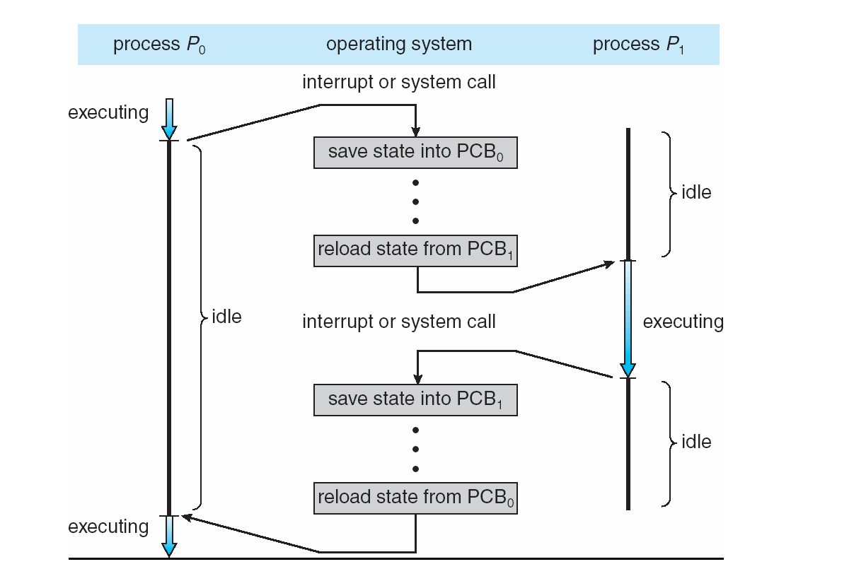
Context Switching
CPU Switch From Process to Process

Slide 11
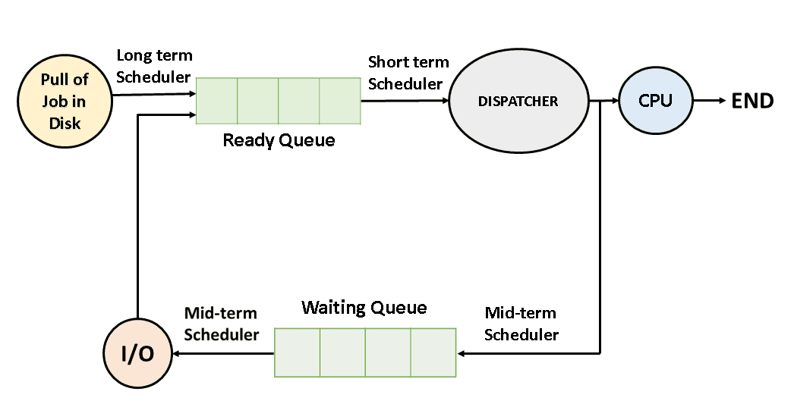
What is CPU Scheduling in OS?

Slide 12
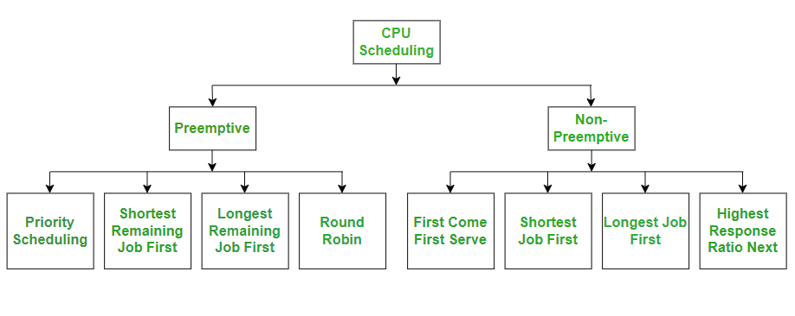
CPU Scheduling or Process scheduling

Slide 13
CPU Scheduling Terminology
CPU utilization – keep the CPU as busy as possible
Throughput – # of processes that complete their execution per time unit
Burst time/ execution time/ running time: is the time process require for running on CPU
Waiting time: time spend by a process in ready state waiting for CPU
Arrival time: when a process enter the ready state
Exit time: when process completes execution and exit from system
Turn around time: total time spend by a process in the system
TAT = ET – AT or BT + WT
Response time: Time between a process enter ready queue and get scheduled on the CPU for the first time

Slide 14
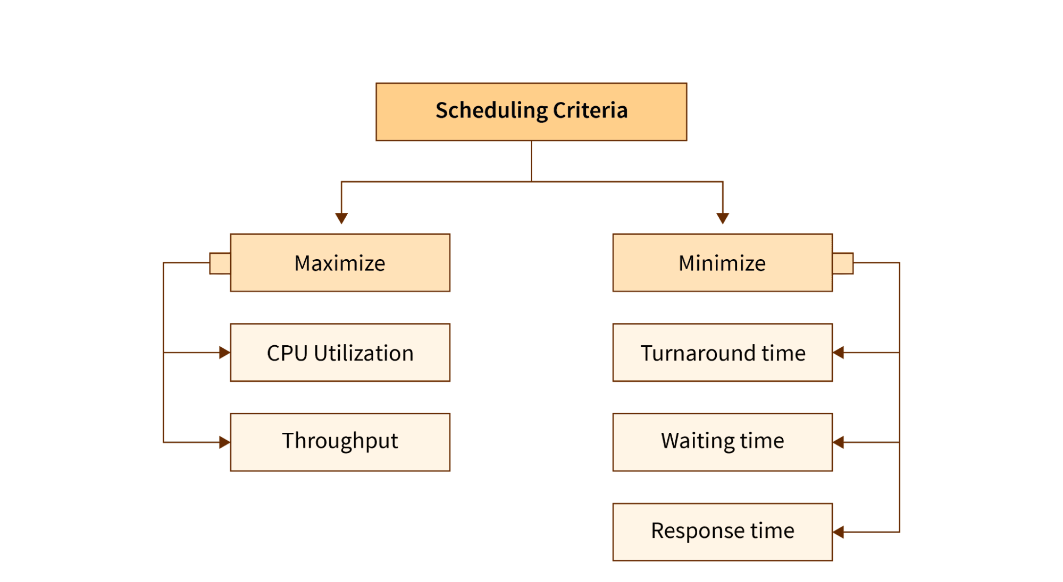
Scheduling Algorithm Optimization Criteria

Slide 15
Activity Slow Learner
Scenario: 1
Imagine a computer system running a multi-programmed operating system. Three processes – P1, P2, and P3 – are loaded into memory.
P1 has just been created and is ready to run.
P2 is currently using the CPU.
P3 has requested input from the keyboard and is waiting for it.
After a few seconds:
P2 finishes its time slice and is moved back to the ready queue.
The OS selects P1 to run on the CPU.
Meanwhile, the keyboard input requested by P3 is received, and it moves to the ready queue.

Slide 16
Activity Slow Learner
Case Study Questions:
What is the current state of P1, P2, and P3 at the beginning of the scenario?
What causes P2 to leave the CPU and move to the Ready state?
Why is P3 in the Waiting state initially?
After the keyboard input is received, what is the new state of P3?
Describe the state transitions for P1 in this scenario.

Slide 17
Activity Slow Learner
Q1. Which process state indicates the process is waiting for an event such as I/O completion? A. Running B. Ready C. Waiting D. Terminated
Q2. What does the OS do when a process finishes its time slice? A. Terminates the process B. Moves it to the waiting queue C. Moves it to the ready queue D. Restarts the process
Q3. What triggers a process to move from the Waiting state to the Ready state? A. Completion of I/O or the awaited event B. Expiration of time slice C. Arrival of new process D. Process crash
Q4. In a preemptive multitasking system, how is the next process selected to run? A. Random selection B. User request C. Scheduler algorithm D. Manual execution
Q5. What is the final state of a process after it completes its execution? A. Waiting B. Ready C. Terminated D. Running

Slide 18
Activity Slow Learner (Story-Based Scenario)
A toy factory has one machine that makes toys. Four toy orders (like processes) arrive at different times and take different amounts of time to finish.
Order (Process) | Arrival Time (in mins) | Time to Finish (Burst Time)
O1 | 0 | 5
O2 | 1 | 3
O3 | 2 | 8
O4 | 3 | 6
The manager must decide which order to process first. They can use different scheduling rules.

Slide 19
Activity Slow Learner
Simple Scheduling Algorithms Explained:
FCFS (First Come First Serve): Serve the order that came first.
SJF (Shortest Job First): Finish the order that takes the least time.
RR (Round Robin): Give each order a chance for 2 minutes, then rotate.
Priority Scheduling: Orders are given a rank. Higher priority goes first
Analysis Questions (With Support Prompts)
Using FCFS, what is the order of processing?
Which order will finish first in SJF?
In Round Robin (Time Slice = 2 mins), which order gets the CPU again after the first round? (Hint: Go around in circles.)
What happens if one order always has a higher priority than the others? (Hint: Will the others ever get processed?)
Which algorithm is fairest to all orders? (Hint: Think about equal turns.)

Slide 20
Activity Slow Learner(Simple Multiple-Choice Quiz)
Q1. What does FCFS stand for? A. Fastest CPU First B. First Come First Serve C. Finish CPU Fast D. First CPU Service
Q2. In SJF, which order is chosen? A. The biggest B. The one with the shortest time C. The one with highest number D. The last one
Q3. Round Robin gives each process: A. No time B. One chance only C. Equal time slices D. Random time
Q4. In a factory with only one machine (CPU), how many orders can be "running" at one time? A. 2 B. 4 C. 1 D. All
Q5. What problem happens if we always choose highest priority only? A. Everyone is happy B. Some orders may starve C. It runs faster D. The machine breaks

Slide 21
Activity Moderate Learner (Case study)
Scenario:2
A modern multitasking operating system is managing four processes: P1, P2, P3, and P4. The system uses a preemptive priority-based CPU scheduling algorithm, where a lower number indicates higher priority.
P1 (Priority: 2) is in the Ready queue. P2 (Priority: 1) is Running on the CPU. P3 (Priority: 3) is in the Waiting state for disk I/O. P4 (Priority: 1) is New and just admitted into memory.
The following events occur:
P2 initiates a file read operation and enters the Waiting state.
The scheduler now chooses the highest priority process from the Ready queue.
P4 finishes loading and enters the Ready queue.
The disk I/O for P3 completes, and it is moved to the Ready queue.
After some time, P4 completes execution and terminates.

Slide 22
Case Study Analysis Questions
After P2 initiates the file read, which process is selected next by the scheduler? Why?
What happens when P4 moves from New to Ready? How does it affect scheduling?
When P3 completes I/O and returns to the Ready state, is it selected to run immediately? Justify your answer using priority levels.
What is the complete life cycle path (states) that P2 follows in this scenario?
Why does P4 terminate without entering the Waiting state? What does this imply about its execution?

Slide 23
Activity Moderate Learner (MCQs Asked in Placement Drives)
Q1. In a preemptive priority-based scheduling system, which factor must the OS consider when selecting the next process? A. I/O burst time B. Process priority C. Process age D. Parent-child relationship
Q2. What causes a context switch between two processes in the scenario above? A. Process termination B. A higher-priority process entering the Ready queue C. Manual user interruption D. Process entering the Waiting state
Q3. Which of the following is true about a process in the New state? A. It can request I/O B. It can be scheduled for CPU C. It has not yet been admitted to the Ready queue D. It is waiting for memory deallocation
Q4. Why does a process enter the Terminated state? A. After being idle too long B. Due to preemption C. After successful or abnormal completion D. If it is moved to the Ready queue
Q5. Which of the following best describes the difference between Ready and Waiting states? A. Ready waits for I/O; Waiting waits for CPU B. Ready is scheduled for CPU; Waiting waits for event completion C. Waiting is selected by scheduler; Ready is not D. There is no difference

Slide 24
Activity Moderate Learner (Story-Based Scenario)
You are a junior system administrator at a mid-sized company. The system handles four user requests (processes), and your task is to analyze how different CPU scheduling algorithms affect performance.
Process | Arrival Time (ms) | Burst Time (ms) | Priority (1 = High)
P1 | 0 | 5 | 3
P2 | 1 | 3 | 1
P3 | 2 | 8 | 2
P4 | 3 | 6 | 4
👉 Use a Gantt chart format to visualize process execution.
FCFS (First Come First Serve), SJF (Shortest Job First – Non-Preemptive), Priority Scheduling (Non-Preemptive)

Slide 25
Activity Moderate Learner
Calculate Metrics for each algorithms
Process | Completion Time | Turnaround Time | Waiting Time
P1
P2
P3
P4
Which algorithm had the lowest average waiting time?
Which process waited the longest in each algorithm?
How does arrival time affect performance in SJF and Priority Scheduling?
If this were a real-time system, which algorithm would be most suitable and why?

Slide 26
Activity Moderate Learner(Simple Multiple-Choice Quiz)
Q1. In FCFS, which process is scheduled first? A. The one with highest priority B. The one with shortest burst time C. The one that arrives first D. Chosen randomly
Q2. What is the main advantage of SJF? A. Reduces turnaround time B. Always fair C. Ignores burst time D. Supports parallel processing
Q3. In Priority Scheduling, a process with priority = 1: A. Will be scheduled last B. Has the highest priority C. Has lowest priority D. Skipped by CPU
Q4. Which scheduling algorithm may cause starvation? A. FCFS B. Round Robin C. SJF D. Priority Scheduling
Q5. Average waiting time is: A. Always zero B. The same in all algorithms C. Total waiting time ÷ number of processes D. Completion time - Burst time

Slide 27
Fast Learner Activity
Scenario: 3
A university's operating system lab team has developed a custom OS kernel. During testing, they observe an unusual behavior: two processes, P1 and P2, both marked as "Running" simultaneously on a single-core system.
Upon investigation, the team inspects the Process Control Blocks (PCBs) of all active processes. Below are the PCB fields for P1, P2, and P3:
Field | P1 | P2 | P3
Process ID | 101 | 102 | 103
Process State | Running | Running | Waiting (I/O)
Program Counter | 0x004A | 0x1F3C | 0x03B2
CPU Registers | Saved | Saved | Saved
Scheduling Info | Priority 2 | Priority 1 | Priority 3
Memory Limits | 0x0000–0x1FFF | 0x2000–0x3FFF | 0x4000–0x5FFF
I/O Status | No pending I/O | No pending I/O | Disk read pending
Accounting Info | 8 ms CPU time | 5 ms CPU time | 3 ms CPU time

Slide 28
Fast Learner Activity (Analysis Questions)
Identify the error in PCB management. What state should P1's PCB have been updated to when P2 was scheduled?
Explain the role of the PCB's Program Counter and CPU Registers during context switching.
How could such an error lead to system instability or incorrect resource management?
Propose two mechanisms that could prevent or detect PCB synchronization issues.
Suppose P3 completes its I/O. Describe the full sequence of changes in its PCB if it becomes the next scheduled process.

Slide 29
Fast Learner Activity
Q1. Which PCB field helps the OS resume a process after preemption? A. Accounting Info B. Memory Limits C. Program Counter D. Process State
Q2. In a well-functioning scheduler, how many PCBs can have the “Running” state on a single-core CPU at a time? A. 0 B. 1 C. 2 D. Unlimited
Q3. Which of the following is NOT typically stored in a PCB? A. Open file descriptors B. CPU temperature C. CPU registers D. Process priority
Q4. What must happen to the PCB during a context switch? A. Delete the PCB of the current process B. Save the CPU context to the PCB C. Remove the I/O status D. Reinitialize memory limits
Q5. A mismatch between a process’s actual execution state and its PCB state can lead to: A. Improved CPU scheduling B. Accurate accounting C. Race conditions and resource conflicts D. Better I/O throughput
Notes:
C – The Program Counter lets the OS resume from where the process left off.
B – Only one process can be “Running” on a single-core system.
B – PCB does not store CPU hardware stats like temperature.
B – Context switch involves saving the CPU context (PC + registers).
C – Incorrect state management may cause race conditions and errors.

Slide 30
Fast Learner Activity
Three process p1, P2 and P3 arrive at time zero. Their total execution time is 10ms, 15ms, and 20ms respectively. They spent first 20% of their execution time in doing I/O, next 60% in CPU processing and the last 20% again doing I/O. For what percentage of time was the CPU free? Use Round robin algorithm with time quantum 5ms.
Process | Execution time | I/O burst | CPU burst | I/O Burst
P1 | 10 | 2 | 6 | 2
P2 | 15 | 3 | 9 | 3
P3 | 20 | 4 | 12 | 4
Notes:
C – The Program Counter lets the OS resume from where the process left off.
B – Only one process can be “Running” on a single-core system.
B – PCB does not store CPU hardware stats like temperature.
B – Context switch involves saving the CPU context (PC + registers).
C – Incorrect state management may cause race conditions and errors.

